Slide 1
Task scheduler

Slide 2
Goals
Create a CRUD program for tasks.
Only accept valid dates.
Users should be able to see which tasks are due on the current day and which are upcoming.

Slide 3
Objects
Task header and source: defines a single task. The user can set title, date, description and location. Description and location are optional. Contains private helper functions for setting the date.
ScheduleList header and source: contains member functions for managing multiple tasks. There are read and write functions for persistence. Tasks are stored in an unordered multimap. The titles and tasks are the keys and values.

Slide 4
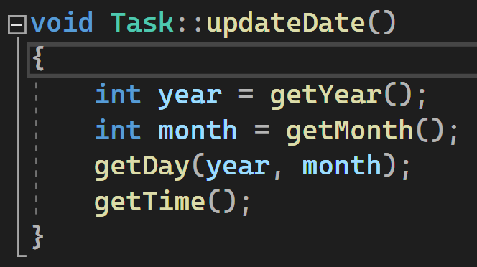
Setting the date
The date for the task is set with
the four helper functions in the
image.
getDay uses the month to check
if there are 31 days or 30, and
year to check Feb 29.
Dates are formatted like so: 2023-03-12 17:35

Slide 5
Setting the month
Only allow user to input 1 to 12
Use chrono library to get month name (requires C++ 20)
Confirm user choice
Update date private member variable

Slide 6
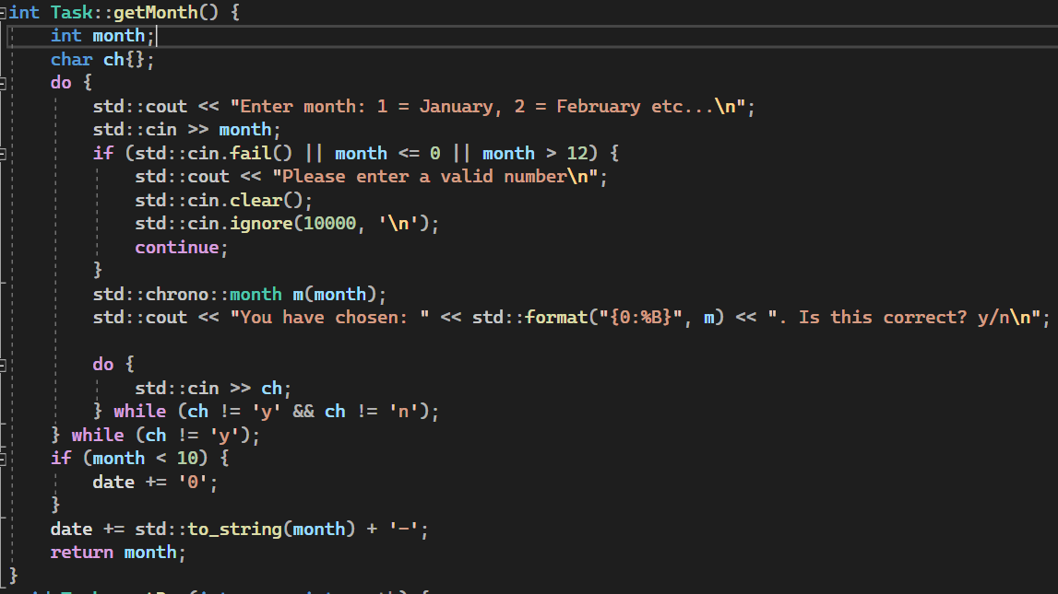
Setting the month

Slide 7
Setting the day
Calculate upper bound (28, 29, 30 or 31) by passing in year and month
Confirm user choice. Print weekday name using std::chrono::year_month_day (requires C++ 20)

Slide 8
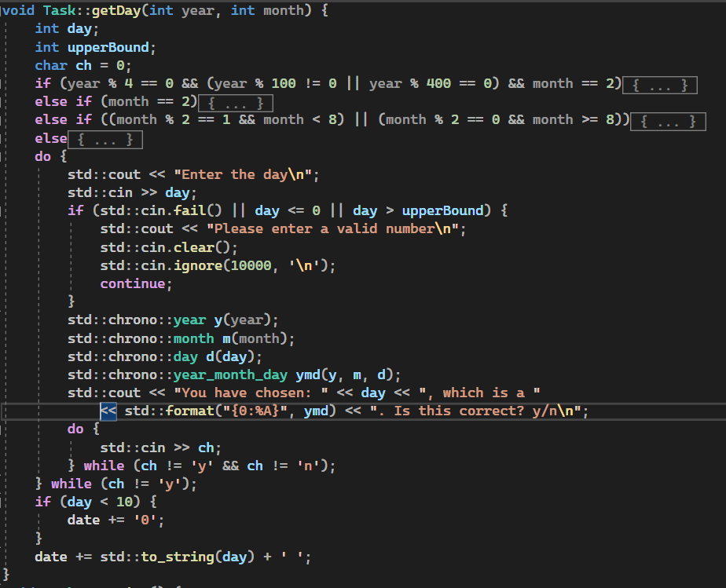
Setting the day

Slide 9
Getting today’s tasks
std::chrono::utc_clock::now() static function returns the current day and time in utc format. (C++ 20)
Format to a string using std::format and a string stream
Compare with dates in the unordered multimap
Display tasks that match current date.

Slide 10
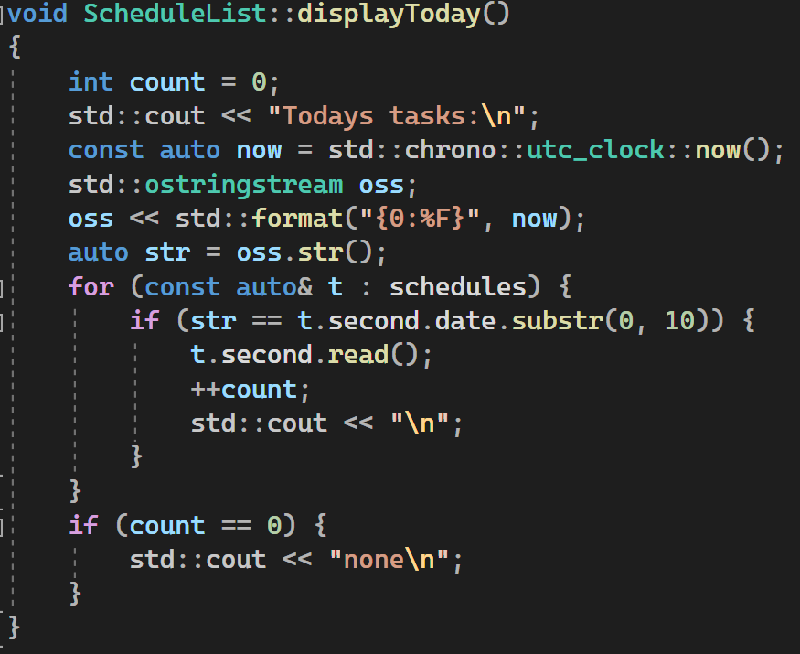
Getting today’s tasks

Slide 11
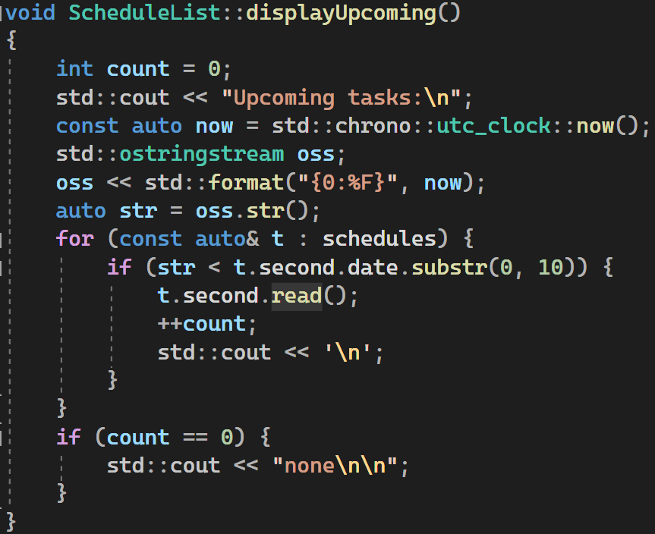
Getting upcoming tasks
Similar to display today's.
Dates compared with < instead of
=
Dates formatted as
2023-03-12 so comparison makes
sense

Slide 12
Getting tasks due since last program execution
If the user creates tasks for a future date, and runs the program again after that date, they can display just those tasks
ScheduleList has a variable lastDate that stores the last date that the program was run
If lastDate < task date < current date, display task

Slide 13
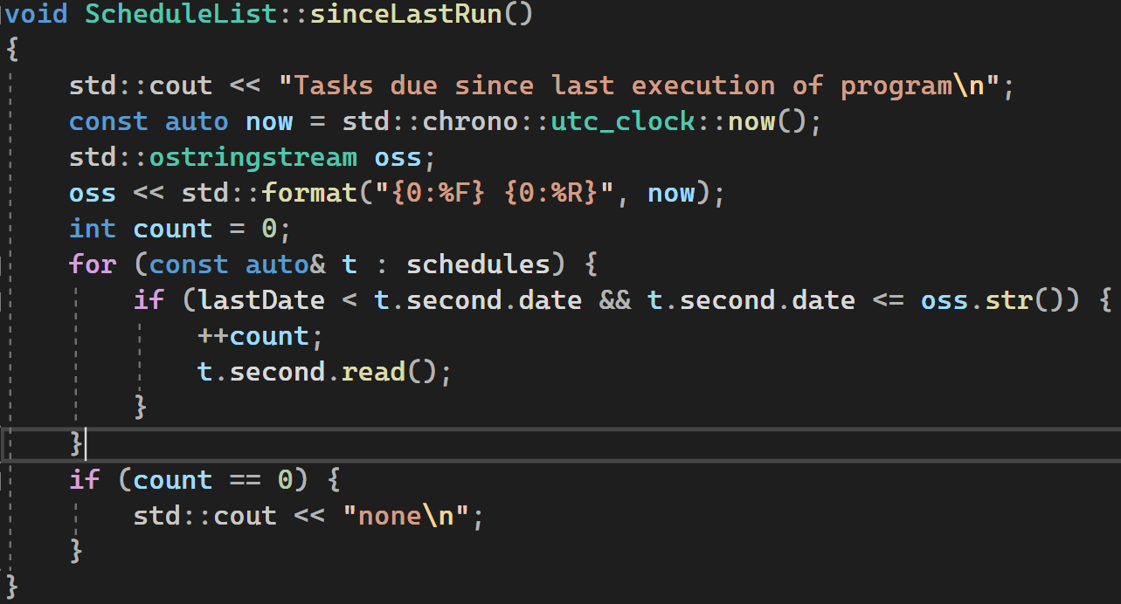
Getting tasks due since last program execution

Slide 14
ScheduleList CRUD
The user is prompted to search the list by title for read, update and delete
For each match found, the user is asked if they want to read/edit it
The functions use equal_range. equal_range has one parameter, the key to search for. It returns a pair of iterators. First iterator points to first in range. Last is one past range.

Slide 15
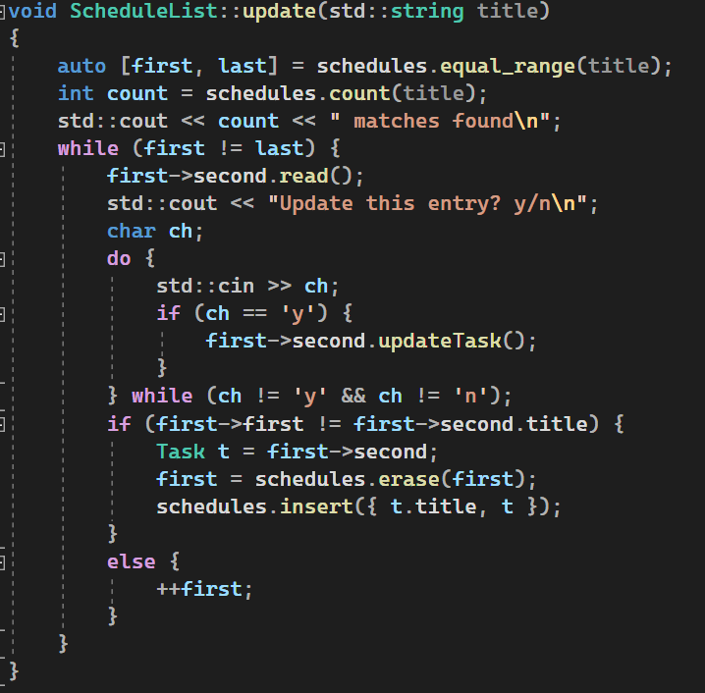
Example: update

Slide 16
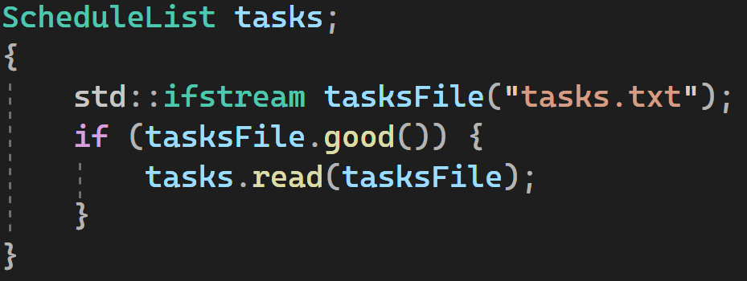
Persistence
Tasks are written to and read from a text file. The top line is lastDate
Data is simply written line by line
In main, the file is only opened if it exists

Slide 17
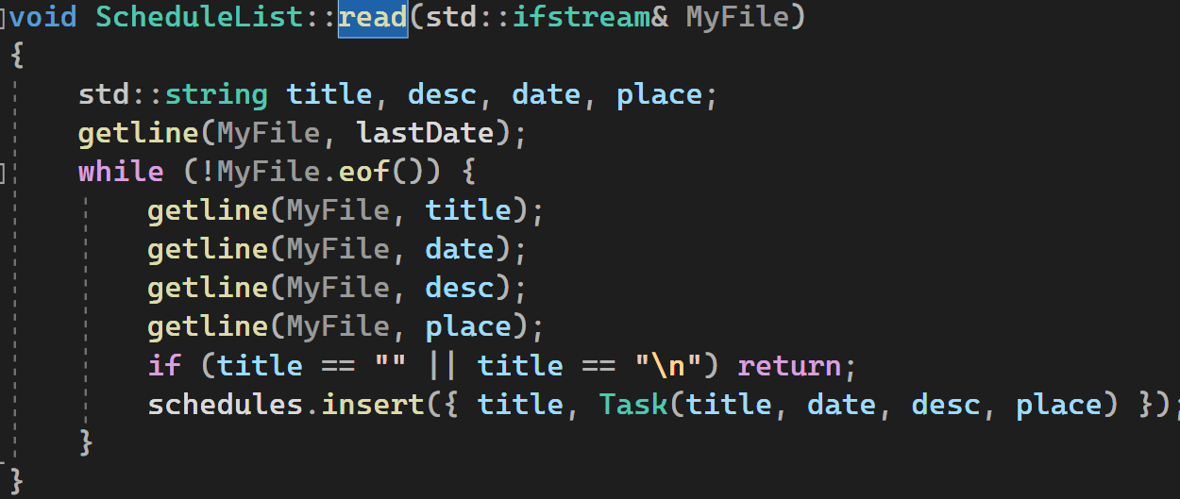
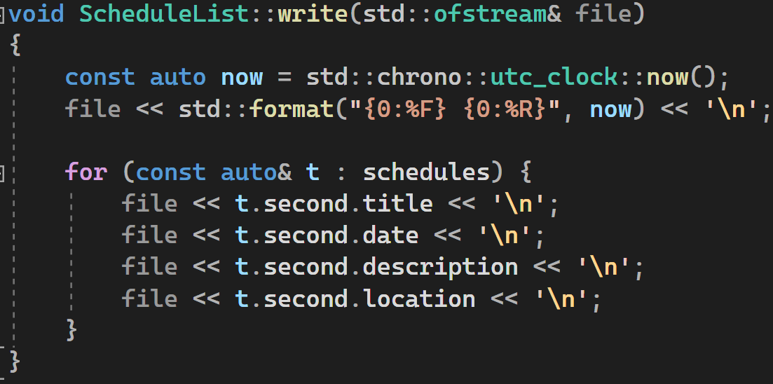
Persistence

Slide 18

Main loop
On start, read in file if it exists
Print choices, process choices
On end, write to file
Start:

Slide 19
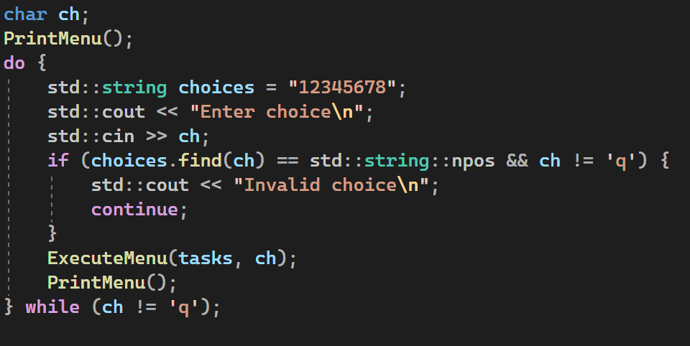
Program loop

Slide 20
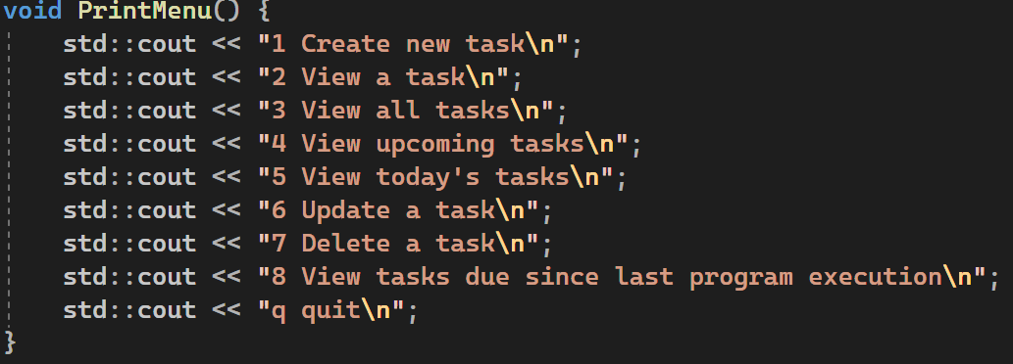
PrintMenu

Slide 21
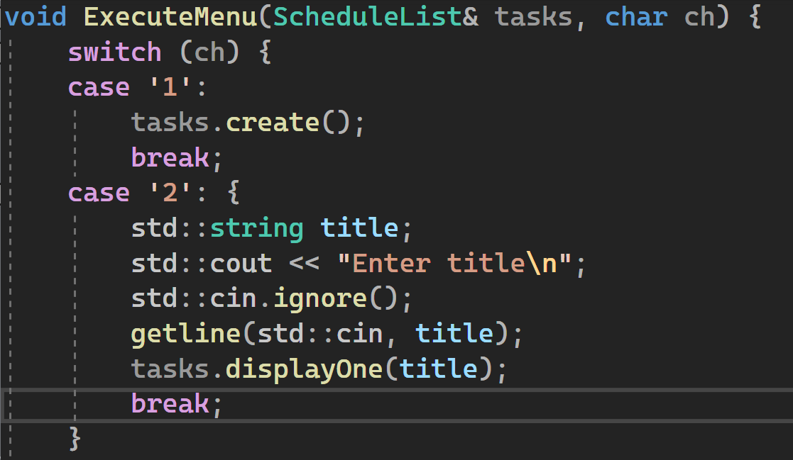
Sample of ExecuteMenu

Slide 22
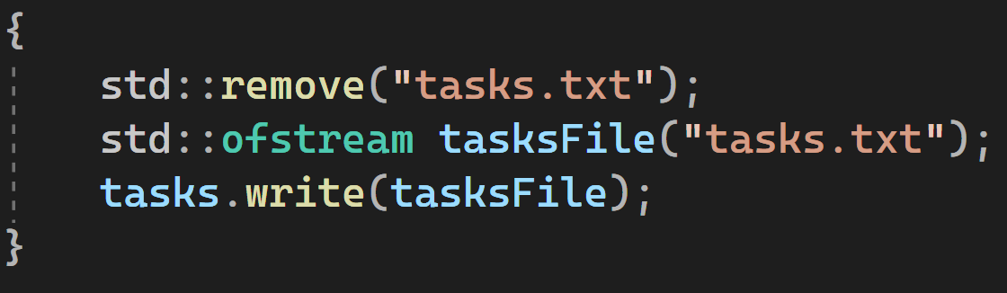
Program end: write to file

